Slide 1
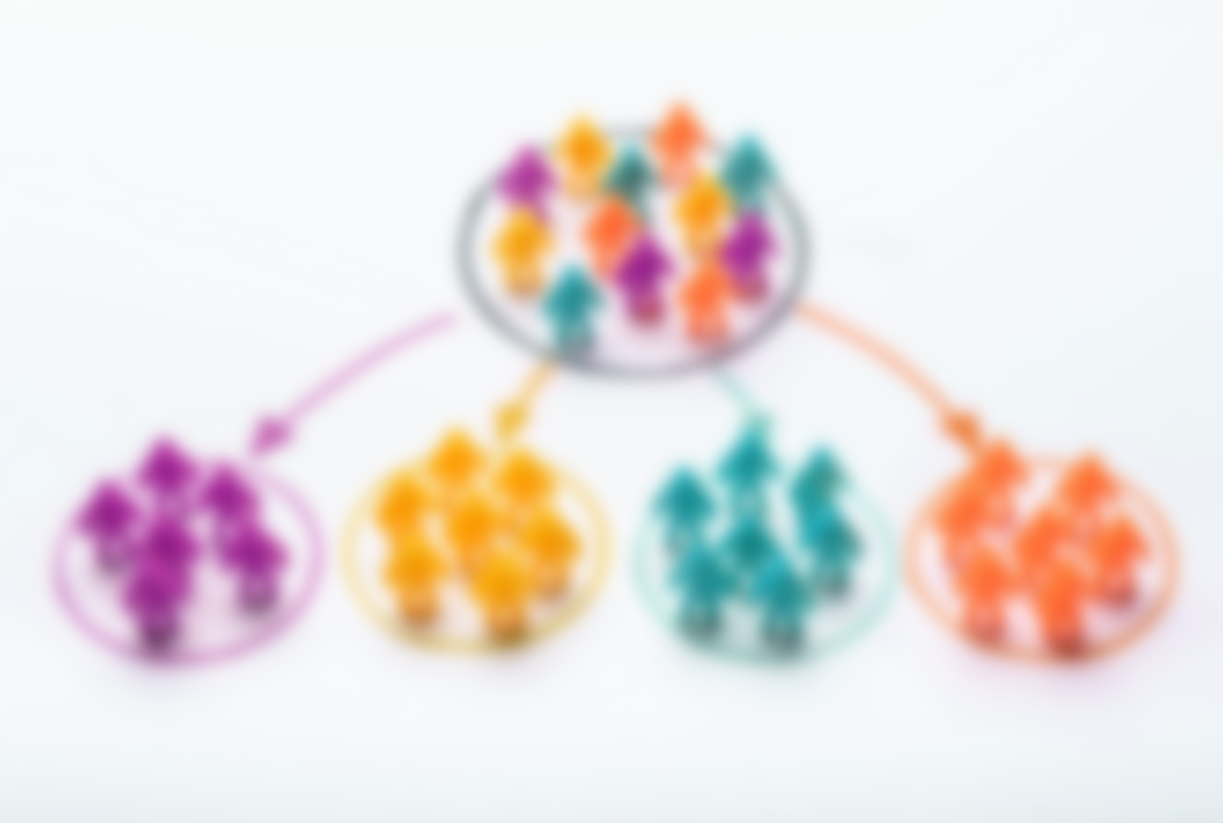
Customer Segmentation
Afternoon Group 16
Akshay Pandey
Manish Addanki
Tejaswini Sajjala
Bhargav Devan Varma Rudraraju
Hadhvika Bodepudi

Slide 2
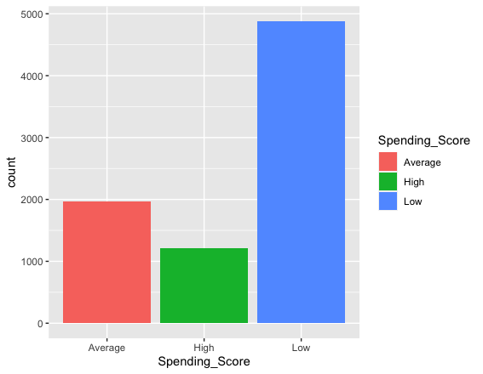
Customer Segmentation
Problem Statement :
Our goal is to provide an optimal way to group customers based on their similarities judging everyone based on their common characteristics which will allow businesses to target each group appropriately and effectively.
The purpose of segmenting consumers is to figure out how to connect with customers from different background based on age, work experience, family size in order to optimize customer advantages.

Slide 3
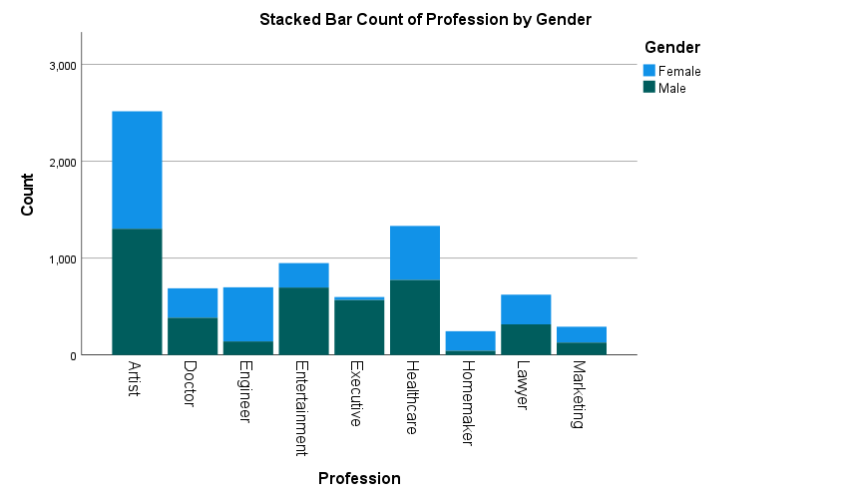
Associated research questions:
Our application’s functionality covers different aspects of research questions which arise at every step:
Data: What is the nature of input data taken for clustering?
Process: Can business users customize number of clusters?
Output: What is the distribution of features among all the clusters e.g., How can we analyze Work Experience and Age for each segment.

Slide 4
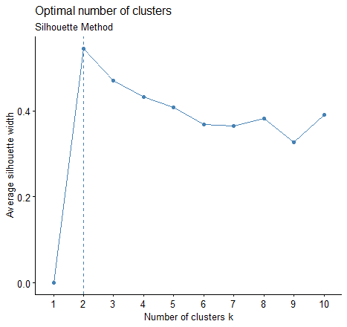
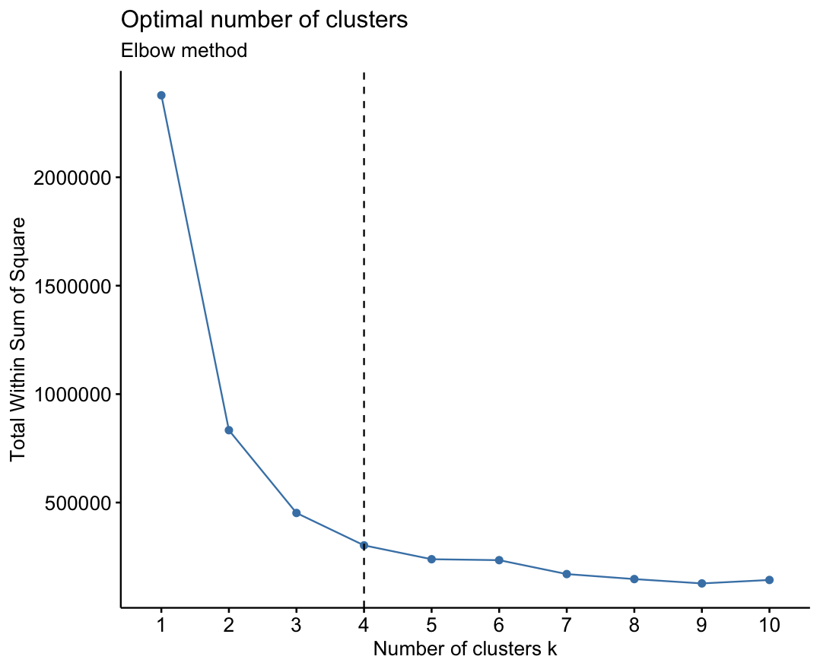
Addressing research questions with Data:
With the help of K-means clustering, we distribute customers into various segments and answer the potential research questions:
We displayed stacked bars, boxplots and bar plots to observe the nature of our dataset.
We derive the relationship between features (e.g., Work Ex vs Age in 4 segments)
Optimal number of clusters for the customer data

Slide 5
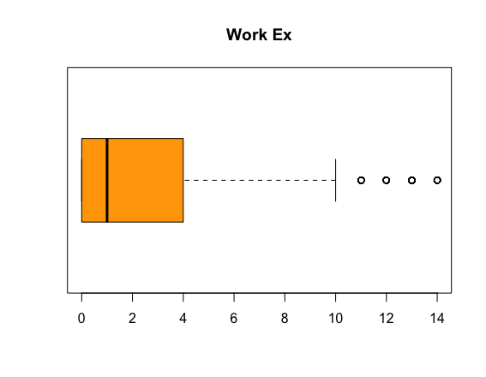
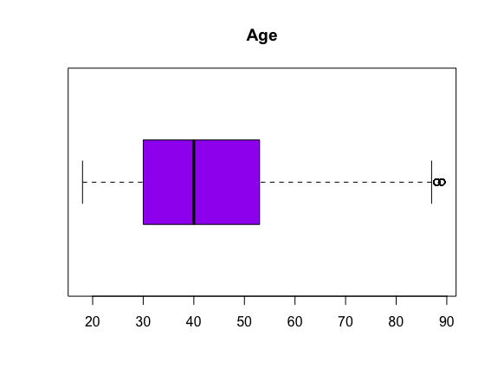
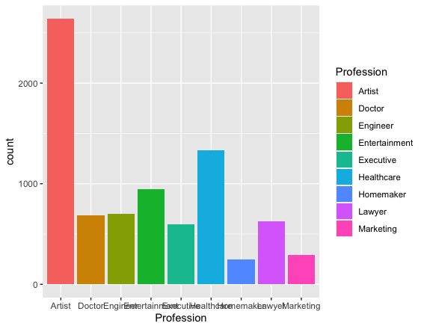
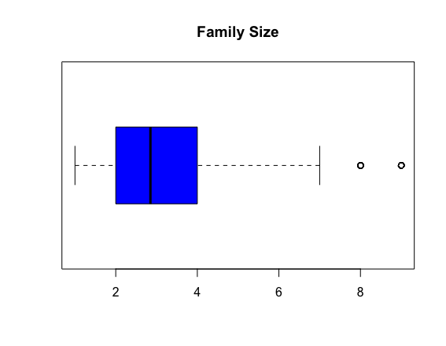
EDA and findings:
Initial analysis displayed the details of scale and categorical variables. The box plot below shows the distribution of Work Ex, Age and Family Size across their mean values.

Slide 6
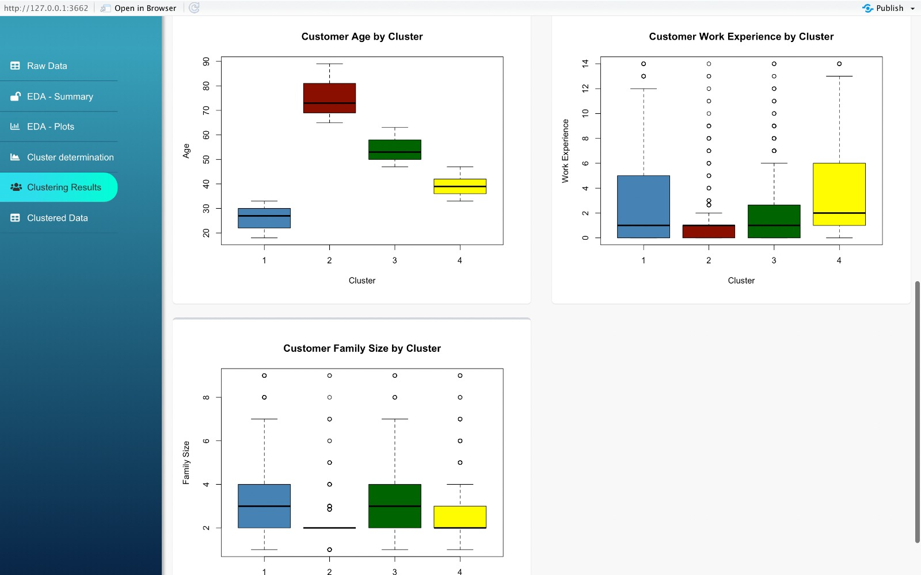
Features / Purpose of Shiny App:
Our R Shiny App allows end users to make decisions with the help of interactive dashboards containing the following features:
EDA – Summary: Displays summary of all the features
Cluster Analysis: Shows boxplots according to clusters
Segmentation Results: Displays the distribution of customers into their respective segments
Business Insights: Derives valuable insights from the segmentation results and answers potential research questions to end users. For example, distribution of age / profession by each segment

Slide 7
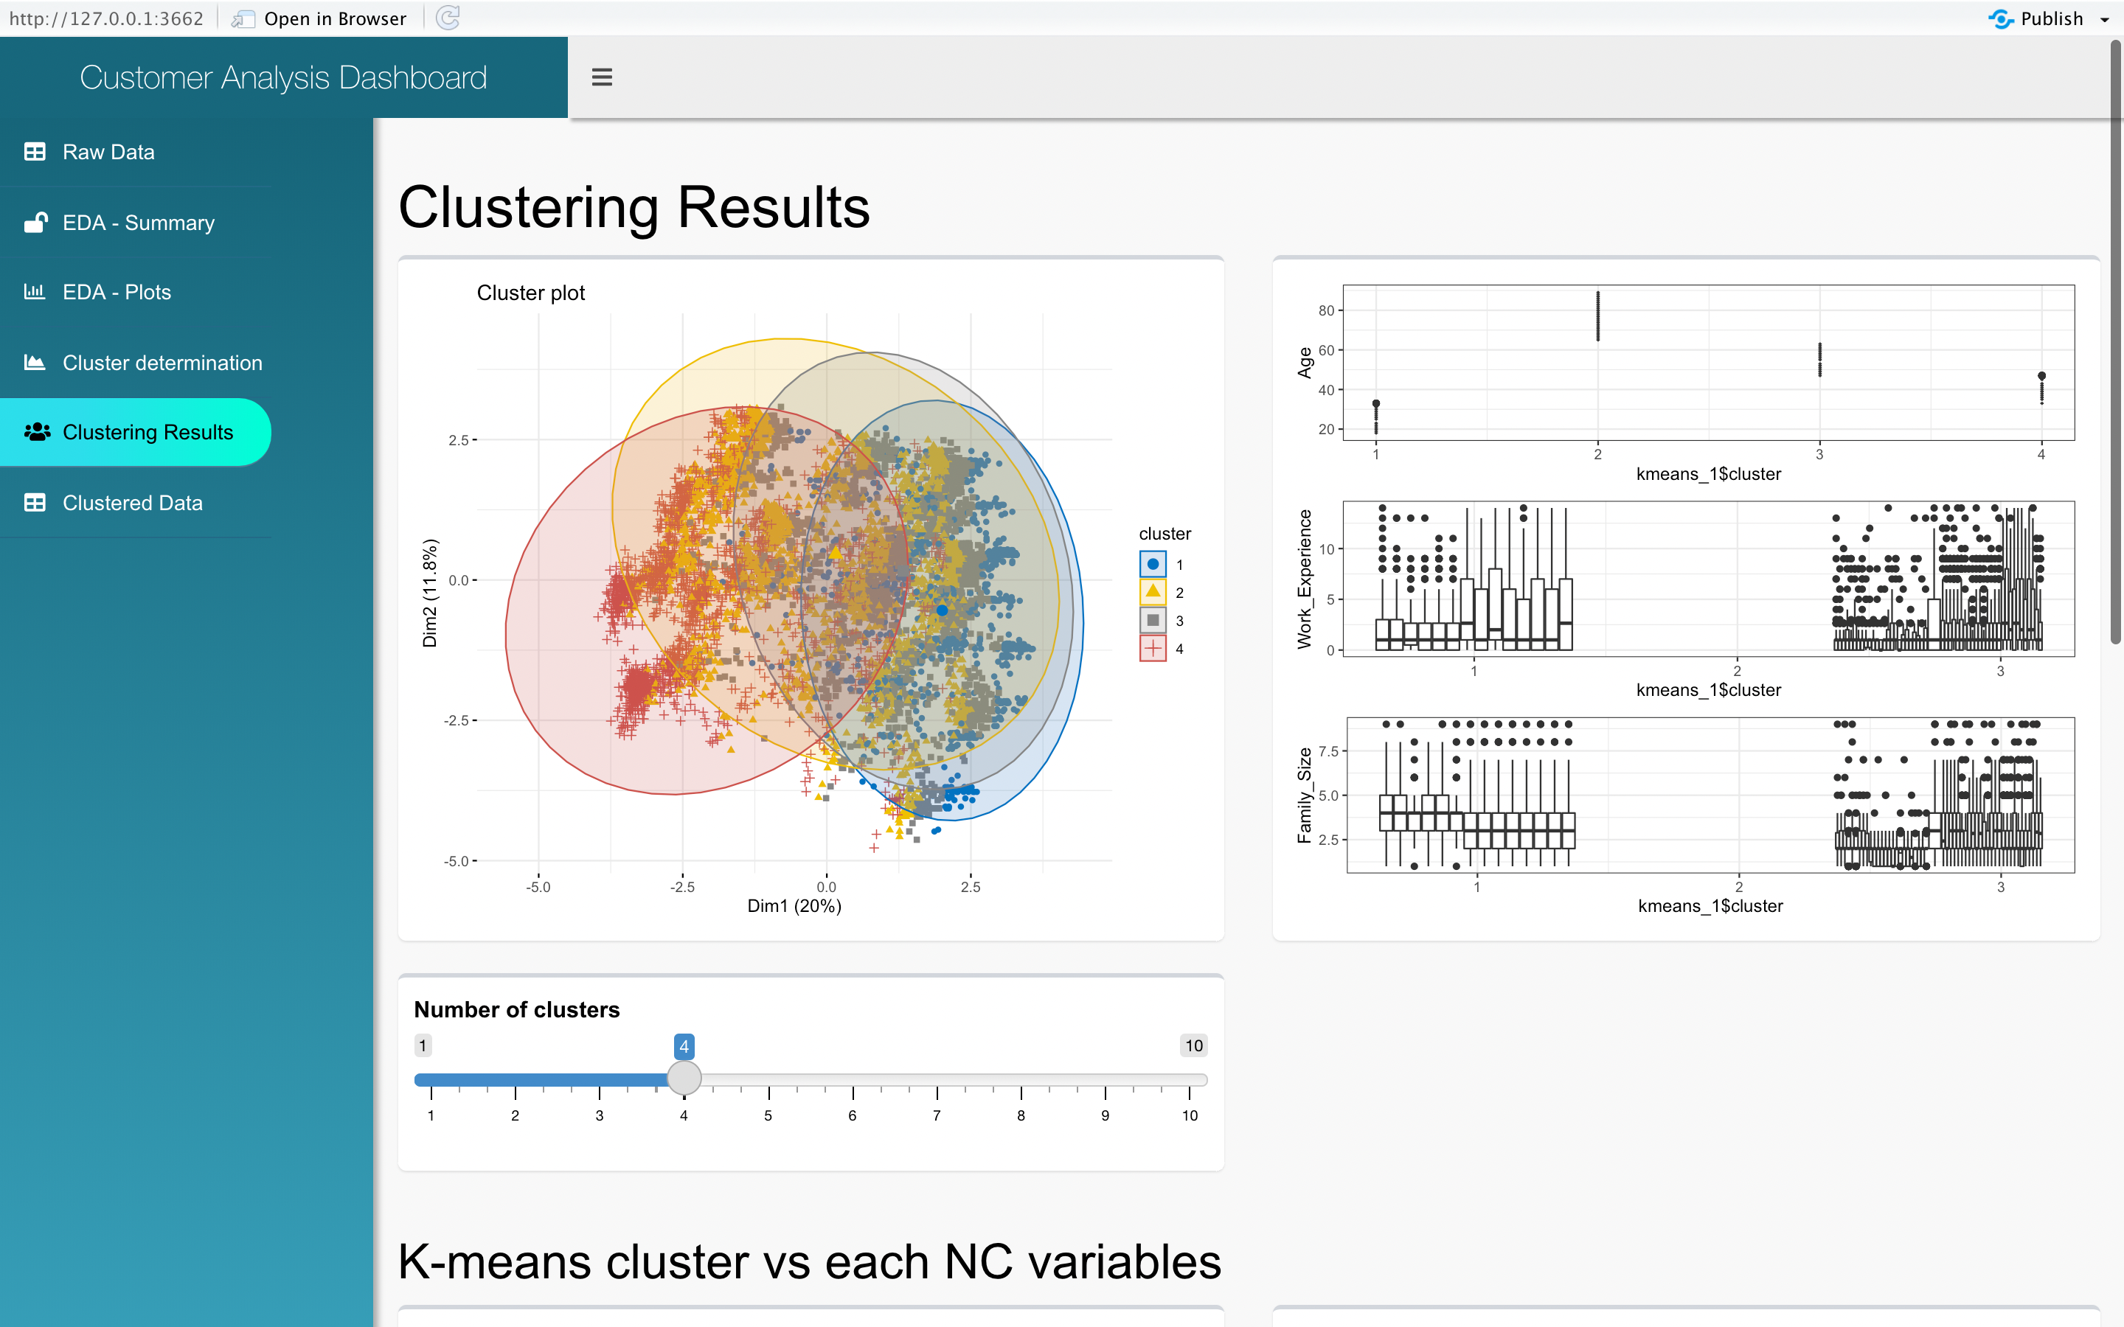
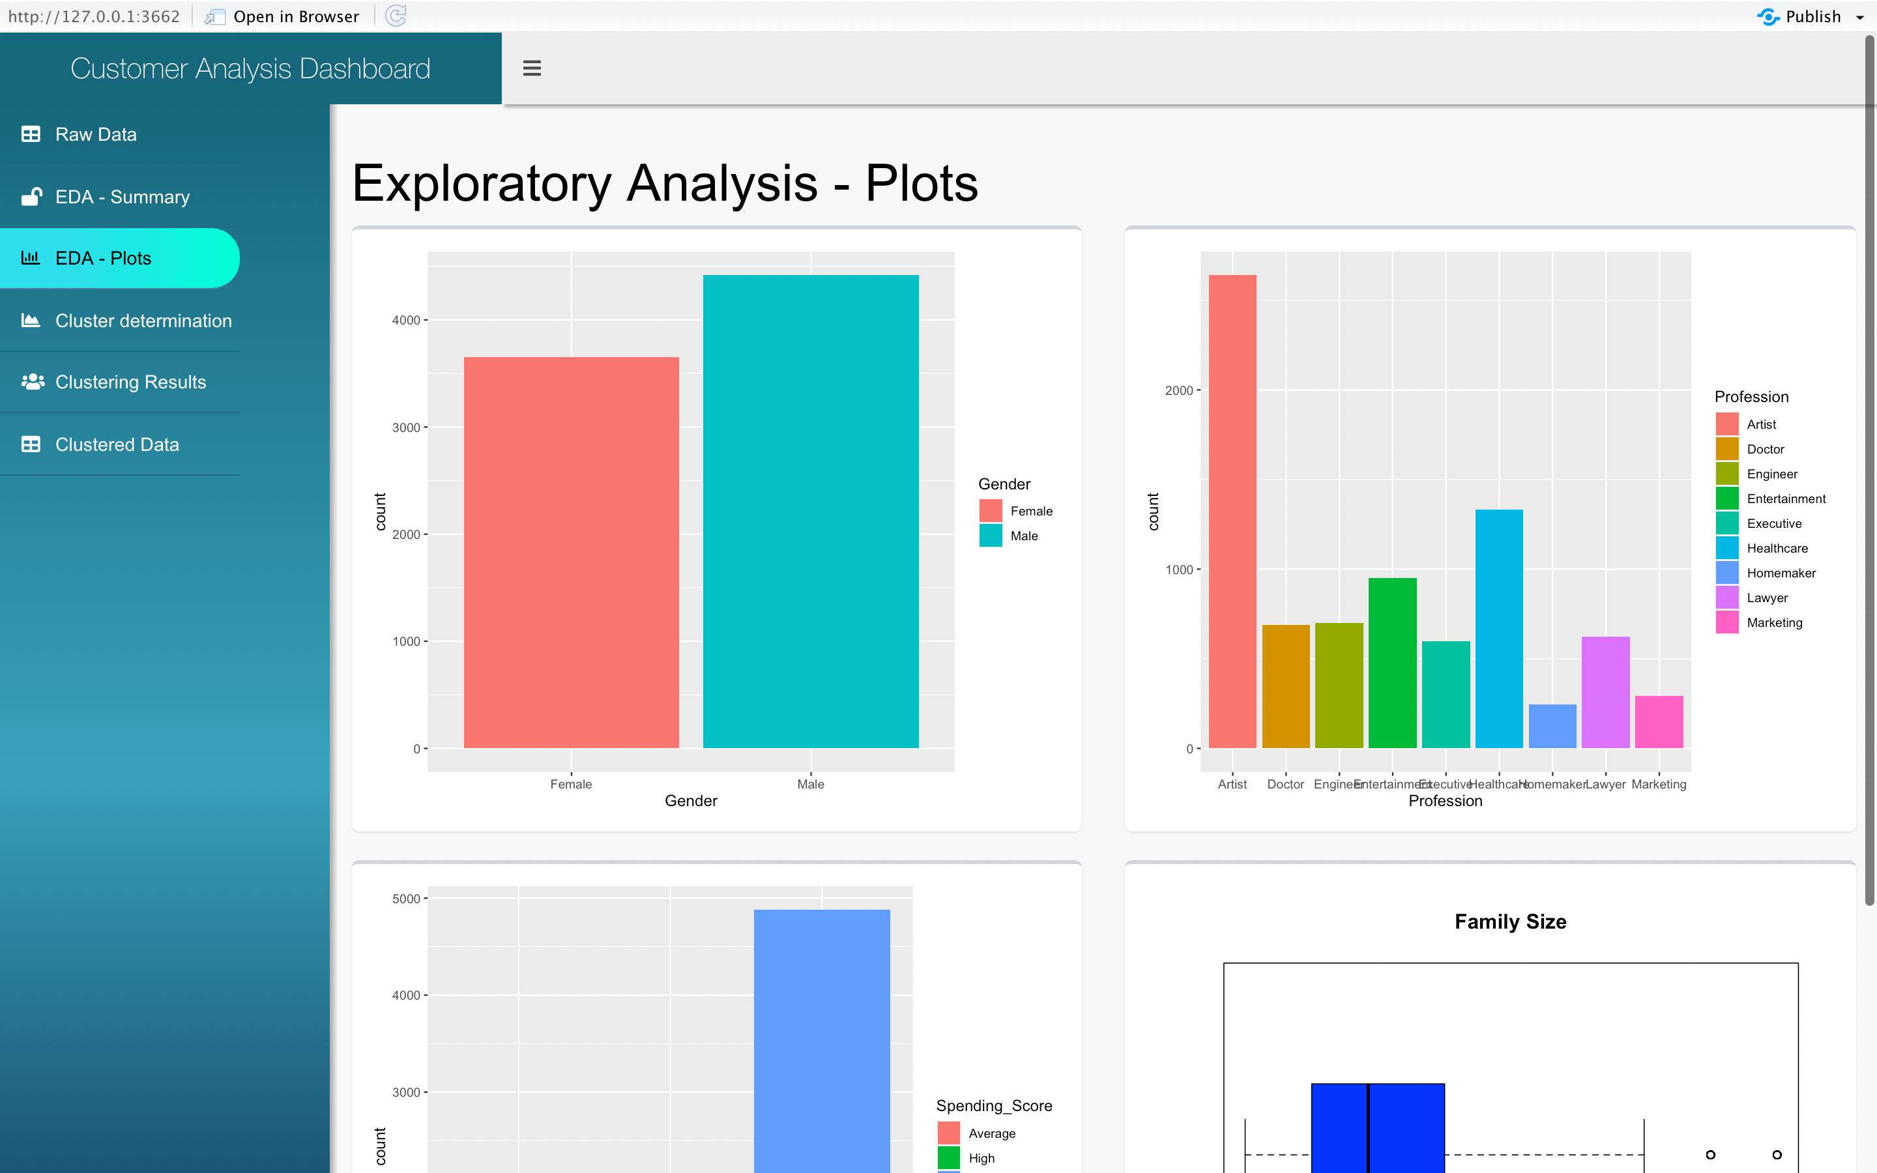
Demonstration of Rshiny App

Slide 8
Impact and Future Research:
Following are the areas of impact :
Data Engineers: App provides data summary
Business Analysts: App describes clusters and methods
Managers/Business Heads: App provides insights generated based on customer segmentation
Following are the research opportunities:
Hyperparameters: Technical users can be given more flexibility in terms of tuning their clustering models from the screen.
Data set upload : Users can be given features to upload the dataset directly from the screen and can perform Analysis and clustering tasks solely from front end without worrying about code.
Roles and Access: App can incorporate additional features based on the end user roles and have a full- fledged account and role management.

